Slide 1
Compiler Design and Construction
Scanners – Finite State Automata

Slide 2
The Scanner
Main goal: recognize words/tokens
Input: characters from the source program.
Groups characters into lexemes
  sequences of characters that "go together"
Output: tokens
  (plus maybe some additional information)
  The scanner has read some input and is on the way to identifying what kind of token has been read.
  (e.g. identifier, operator, integer literal, etc.)

Slide 3
The scanning process
Specify what needs to be recognized.
  Some tokens are easy to identify
    e.g. = is an assignment operator, ( is a parenthesis
  Others are more complex
    How would the scanner recognize an identifier? The set of possible identifiers is very large or even infinite (assuming no length restrictions)
    SOLUTION: Recognize a pattern!
      Example: An identifier is a sequence of letters or digits that starts with a letter.
      We need a way to describe this pattern to our scanner generator.
        Regular expressions come to the rescue!

Slide 4
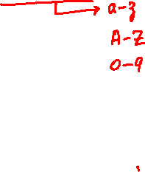
The scanning process
Definition: Regular expressions (over alphabet Σ)
  ε is an RE denoting {ε}
  If α∈Σ, then α is an RE denoting {α}
  If r and s are REs, then
    (r) is an RE denoting L(r)
    r|s is an RE denoting L(r)∪L(s)
    rs is an RE denoting L(r)L(s)
    r* is an RE denoting the Kleene closure of L(r)
Property: REs are closed under many operations
  This allows us to build complex REs.

Slide 5
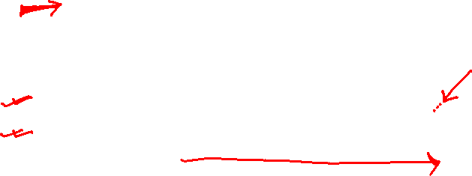
Regular Definitions
A regular expression that describes digits is:
0|1|2|3|4|5|6|7|8|9
For convenience, we'd like to give it a name and then use the name in building more complex regular expressions:
digit → 0|1|2|3|4|5|6|7|8|9
This is called a regular definition.
Example
  letter → a|...|z|A|...|Z
  ident → letter (letter | digit)*

Slide 6
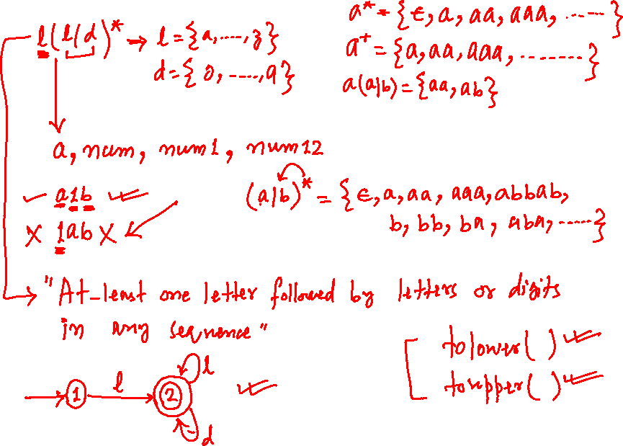

Slide 7
What’s next!!!
Given an input string, we need a “machine” that has a regular expression hard-coded in it and can tell whether the input string matches the pattern described by the regular expression or not.
A machine that determines whether a given string belongs to a language is called a finite automaton.

Slide 8
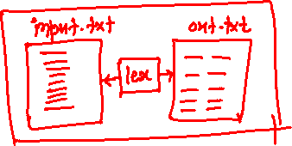
The scanning process
Definition: Deterministic Finite Automaton
  a five-tuple (Σ, S, δ, s₀, F) where
    Σ is the alphabet
    S is the set of states
    δ is the transition function (S×Σ→S)
    s₀ is the starting state
    F is the set of final states (F ⊆ S)

Slide 9
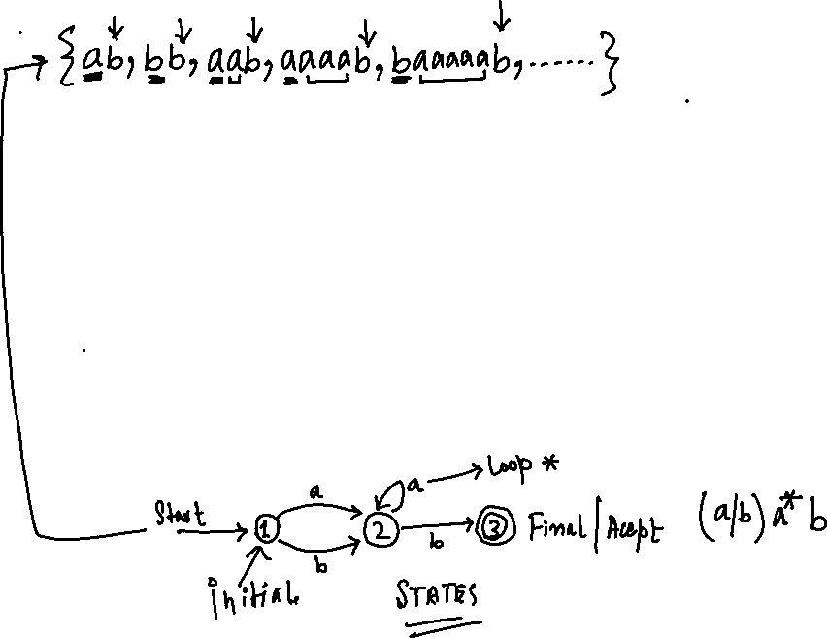
Cont..
Notation:
  Use a transition diagram to describe a DFA
    states are nodes, transitions are directed, labeled edges, some states are marked as final, one state is marked as starting
    If the automaton stops at a final state on end of input, then the input string belongs to the language.

Slide 10

Cont..
Goal: automate the process
Idea:
  Start with an RE
  Build a DFA
    How?
      We can build a non-deterministic finite automaton (Thompson's construction)
      Convert that to a deterministic one
      (Subset construction)
      Minimize the DFA
      (Hopcroft's algorithm)
  Implement it

Slide 11
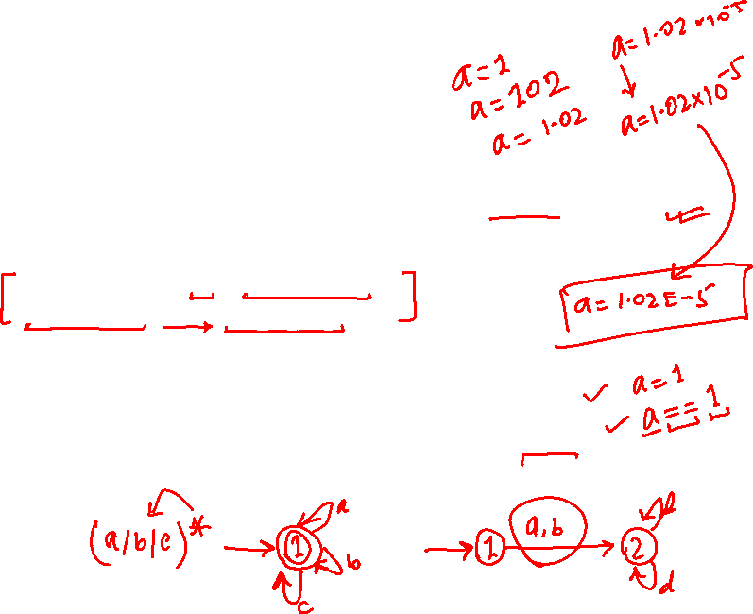
Syntax Definition
To specify the syntax of a language : Backus-Naur Form(BNF) or Context Free Form(CFG)
  Example : if-else statement in C has the form of statement → if ( expression )
  statement else statement
An alphabet of a language is a set of symbols.
  Examples : {0,1} for a binary number system(language)={0,1,100,101,...}
  {a,b,c} for language={a,b,c, ac,abcc..}
  {if,(,),else ...} for a if statements={if(a==1)goto10, if--}

Slide 12
Cont..
A string over an alphabet
  is a sequence of zero or more symbols from the alphabet.
  Examples : 0,1,10,00,11,111,0202 ... strings for a alphabet {0,1}
  Null string is a string which does not have any symbol
  of alphabet.
Language
  Is a subset of all the strings over a given alphabet.
  Alphabets Ai Languages Li for Ai
  A0={0,1} L0={0,1,100,101,...}
  A1={a,b,c} L1={a,b,c, ac, abcc..}
  A2={all of C tokens} L2= {all sentences of C program }

Slide 13
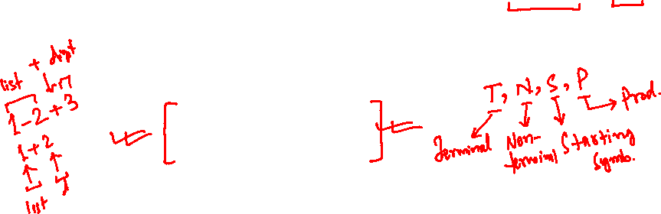

Cont..
Example: Grammar for expressions consisting of digits and plus and minus signs.
  Language of expressions L={9-5+2, 3-1, ...}
  The productions of grammar for this language L are:
list → list + digit
list → list - digit
list → digit
digit → 0|1|2|3|4|5|6|7|8|9
  list, digit : Grammar variables, Grammar symbols
  0,1,2,3,4,5,6,7,8,9,-,+ : Tokens, Terminal symbols

Slide 14
Convention specifying grammar
Terminal symbols : bold face string if, num, id
Nonterminal symbol, grammar symbol : italicized names, list, digit, A,B
Grammar G=(N,T,P,S)
  N : a set of nonterminal symbols
  T : a set of terminal symbols, tokens
  P : a set of production rules
  S : a start symbol, S∈N

Slide 15
Cont..
Grammar G for a language L={9-5+2, 3-1, ...}
  G=(N,T,P,S)
  N={list,digit}
  T={0,1,2,3,4,5,6,7,8,9,-,+}
  P : list --> list + digit
list --> list - digit
list --> digit
digit --> 0|1|2|3|4|5|6|7|8|9
  S=list

Slide 16
Derivation for a language L and its grammar G
A sequence of replacements S⇒α1⇒α2⇒…⇒αn is a derivation of αn.
Example, A derivation 1+9 from the grammar G
  left most derivation
  list ⇒ list + digit ⇒ digit + digit ⇒ 1 + digit
  ⇒ 1 + 9
  right most derivation
  list ⇒ list + digit ⇒ list + 9 ⇒ digit + 9 ⇒ 1 + 9

Slide 17
Parse Tree for a language L and its grammar G
A derivation can be conveniently represented by a derivation tree( parse tree).
  The root is labeled by the start symbol.
  Each leaf is labeled by a token or ε.
  Each interior is labeled by a nonterminal symbol.
    root : the start symbol
    internal nodes : nonterminal
    leaf nodes : terminal

Slide 18
Cont..
Example G:
  list -> list + digit | list - digit | digit
  digit -> 0|1|2|3|4|5|6|7|8|9
left most derivation for 9-5+2,
  list ⇒ list+digit ⇒ list-digit+digit
  ⇒ digit-digit+digit ⇒ 9-digit+digit
  ⇒ 9-5+digit ⇒ 9-5+2
right most derivation for 9-5+2,
  list ⇒ list+digit ⇒ list+2 ⇒ list-digit+2 ⇒ list-5+2 ⇒ digit-5+2 ⇒ 9-5+2

Slide 19
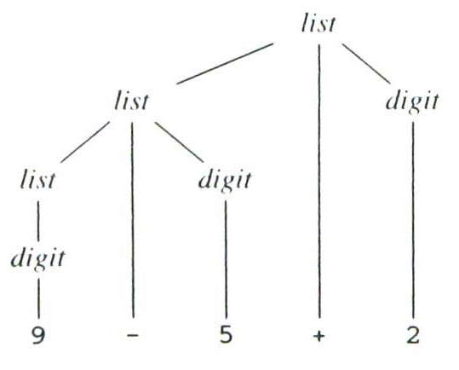
Cont..
Parse tree for 9-5+2 according to the grammar in Example

Slide 20
Ambiguity
A grammar is said to be ambiguous if the grammar has more than one parse tree for a given string of tokens.
  Example: Suppose a grammar G
  G : string → string + string | string - string |0|1|2|3|4|5|6|7|8|9

Slide 21
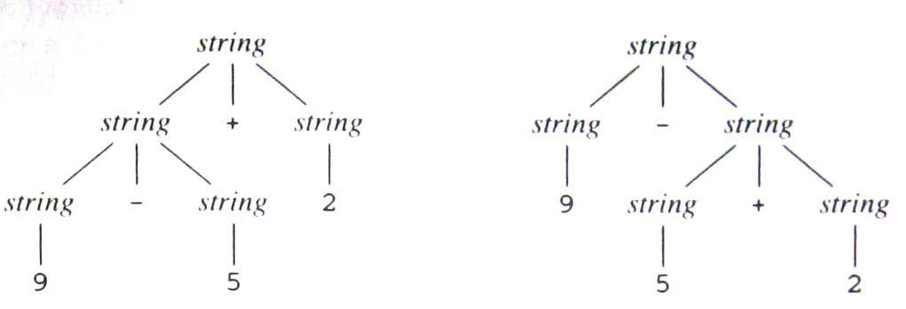
Cont..
Two Parse tree for 9-5+2

Slide 22

SYNTAX-DIRECTED TRANSLATION (SDT)
A formalism for specifying translations for programming language constructs.
Postfix notation for an expression E
  If E is a variable or constant, then the postfix nation for E is E itself ( E.t≡E ).
  if E is an expression of the form E1 op E2 where op is a binary operator
    E1: is the postfix of E1,
    E2: is the postfix of E2
    then E1 E2 op is the postfix for E1 op E2

Slide 23
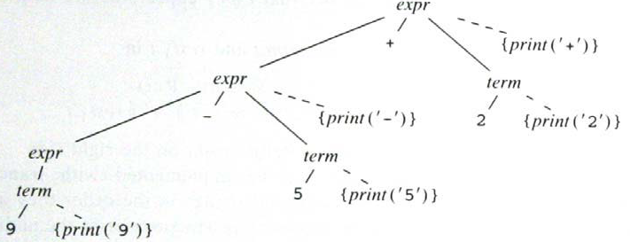
Cont..
Actions translating 9-5+2 into 95-2+ (Depth First)

Slide 24
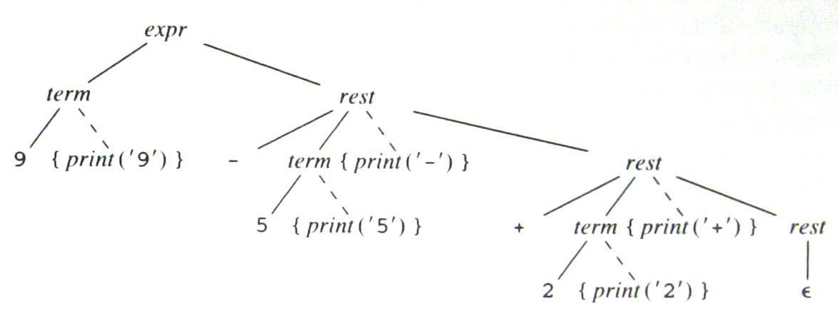
Cont..
Actions translating 9-5+2 into 95-2+ (Depth First left to right)

Slide 25
PARSING
Top-Down parsing
  1. At node n labeled with nonterminal A, select one of the productions whose left part is A and construct children of node n with the symbols on the right side of that production.
  2. Find the next node at which a sub-tree is to be constructed.

Slide 26
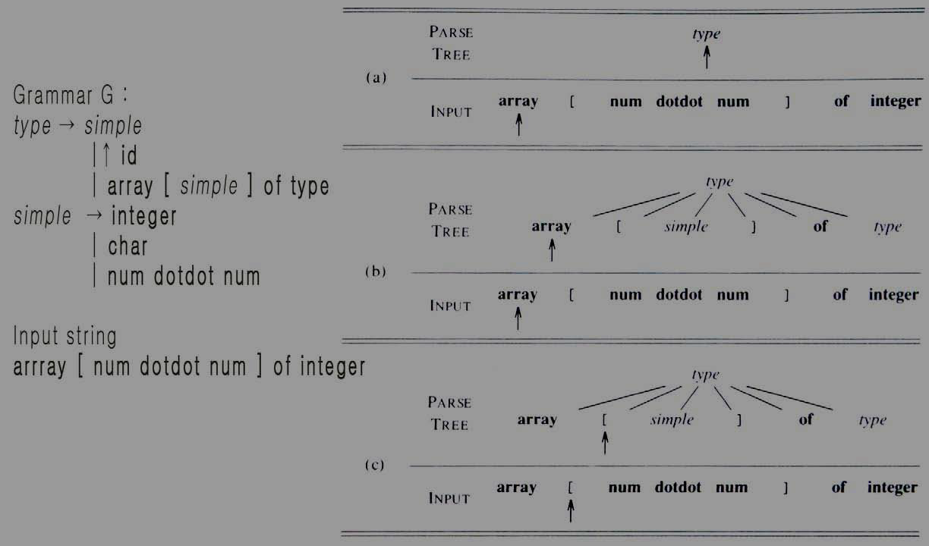
Cont..
Top-down parsing while scanning the input from left to right.

Slide 27
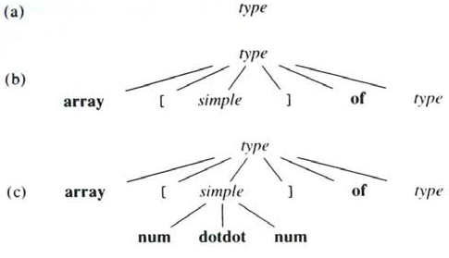
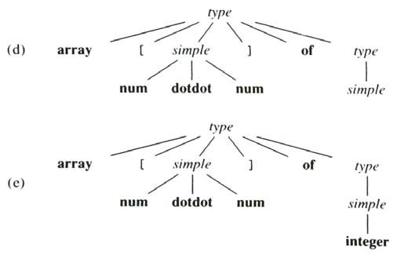
Cont..
Steps in the top-down construction of a parse tree.

Slide 28
LEXICAL ANALYSIS
Reads and converts the input into a stream of tokens to be analyzed by parser.
lexeme : a sequence of characters which comprises a single token.
Lexical Analyzer →Lexeme / Token → Parser
Removal of White Space and Comments
Remove white space(blank, tab, new line etc.) and comments
Contsants
Constants: For a while, consider only integers
E.g: input 31 + 28, output(token representation)?
    input : 31 + 28
    output: <num, 31> <+, > <num, 28>
    num + :token
    31 28 : attribute, value(or lexeme) of integer token num

Slide 29
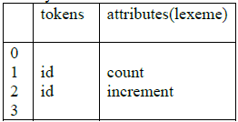
Cont..
Recognizing
Identifiers
  Identifiers are names of variables, arrays, functions...
  A grammar treats an identifier as a token.
  E.g: input : count = count + increment;
  output : <id,1> <=, > <id,1> <+, > <id, 2>;
  Symbol table:

Slide 30
Cont..
Keywords are reserved, i.e., they cannot be used as identifiers.
Then a character string forms an identifier only if it is no a keyword.
punctuation symbols
  Operators : + - * / := < > …

Slide 31
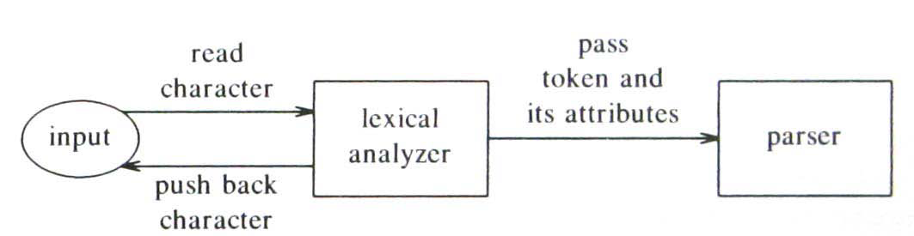
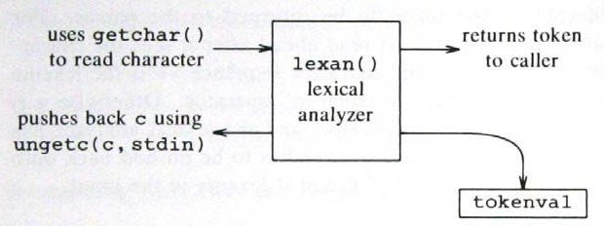
Cont..
Interface to lexical analyzer
A Lexical Analyzer: (Implementing the interactions)

